Slide 1
Model Cars Analytics Report: Operational & Sales Insights

Slide 2
Overview
This project leverages SQL-driven data analysis to support strategic business operations for Classic Model Cars.
Through exploring modelcars.db, a relational database, the project surfaces critical patterns in sales, staffing,
inventory, and customer behavior.
Scope: Customers, Employees, Orders, Products, and Offices
Techniques Used: SQL queries, stored procedures, triggers
Strategic Goals:
  Identify sales-driving reps and offices
  Segment customers based on credit and buying behavior
  Analyze product demand and inventory status
  Automate key business functions through triggers

Slide 3
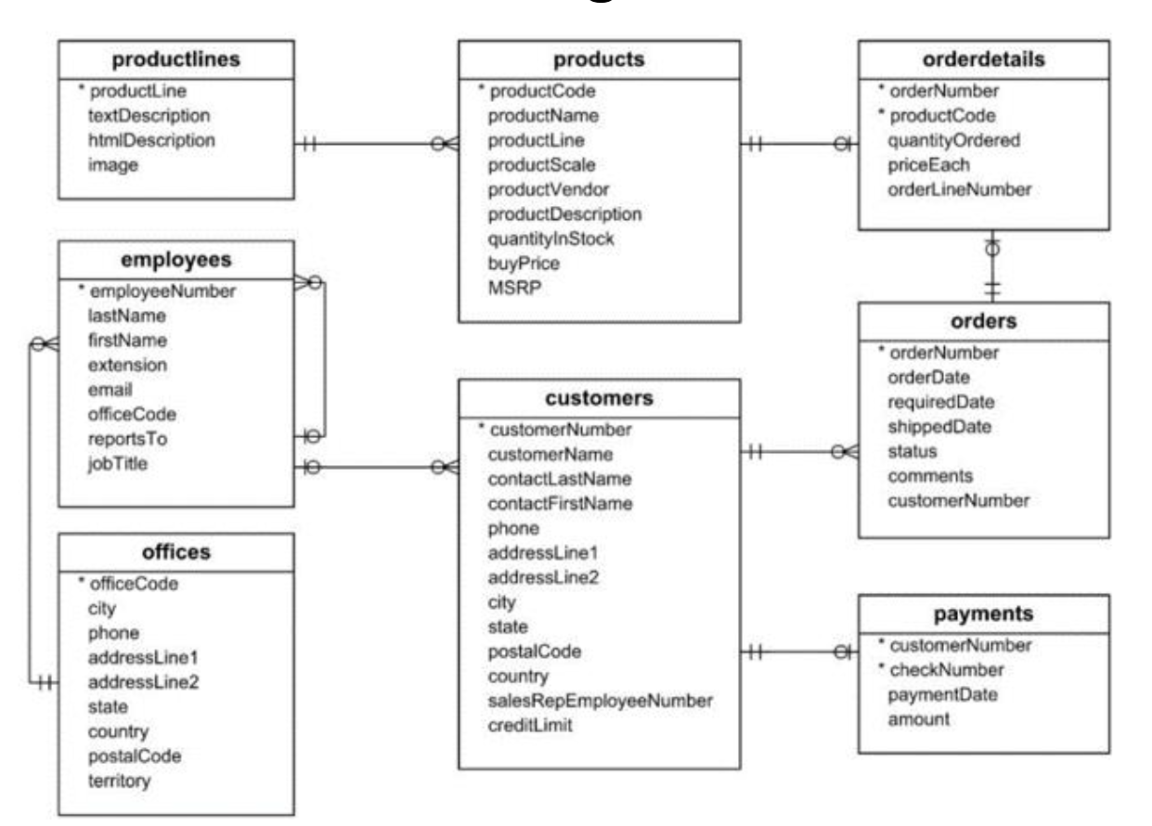
Entity-Relationship (ER) Diagram Overview
The ER diagram illustrates the relational structure of the modelcars.db database.
Key relationships:
  Customers place Orders, which contain Order Details linked to Products.
  Employees are linked to Customers as sales representatives.
  Employees work in Offices, organized by region.
It provides a clear view of data flow across business entities like sales, inventory, and customer management etc.

Slide 4
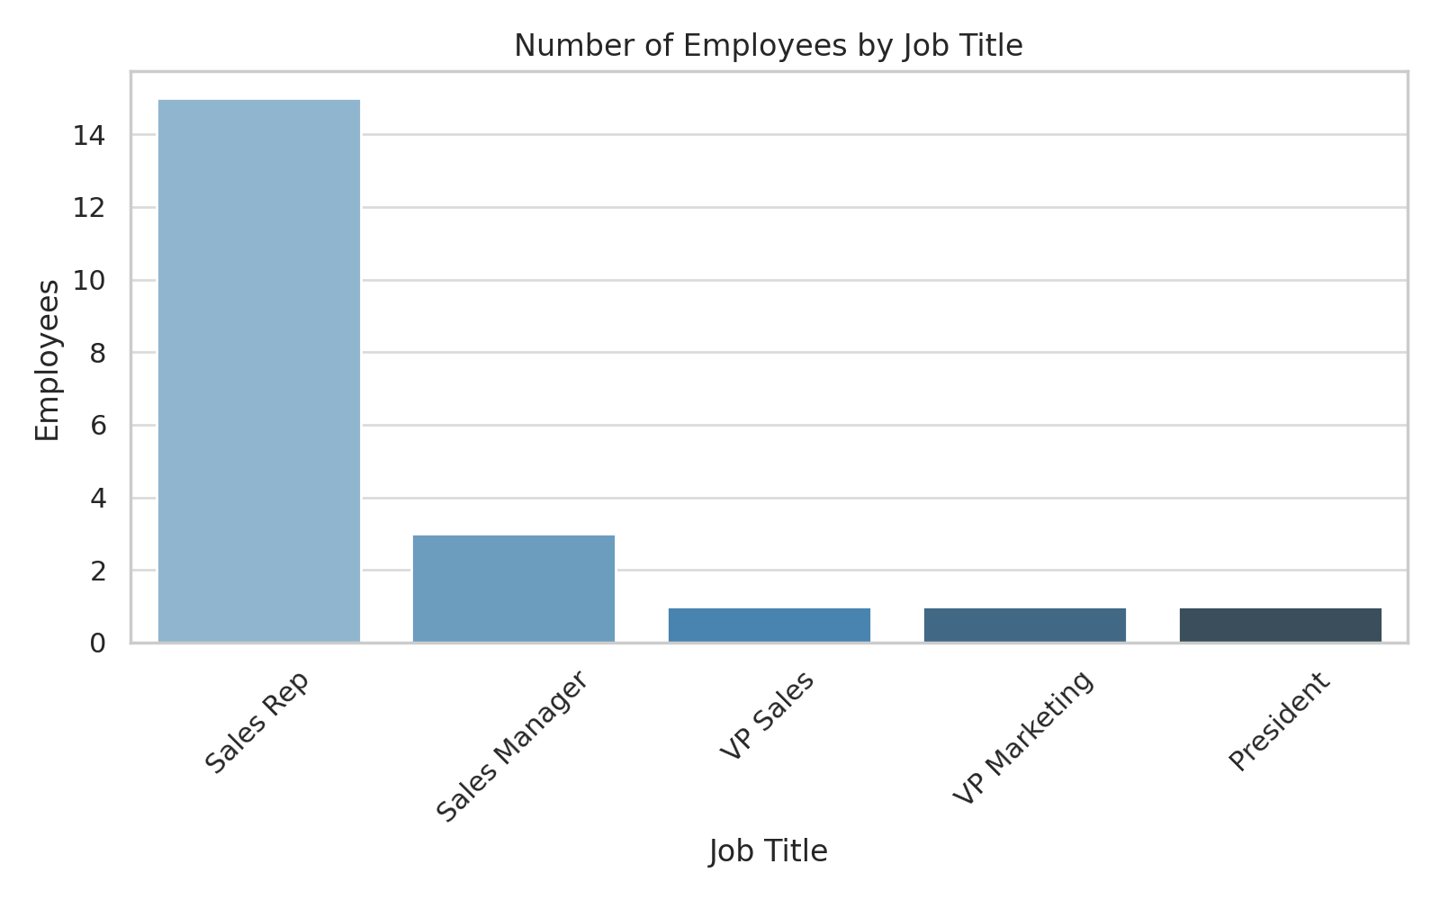
Workforce Structure Analysis
Total Employees: 23 across 7 global offices
Role Distribution:
  1 President, 2 Vice Presidents, 3 Sales Managers, 17 Sales Representatives
Leadership Insight:
  President Diane Murphy (San Francisco) leads without direct reports, VPs manage team hierarchies
Business Implication: Balanced hierarchy allows top-down decision-making

Slide 5
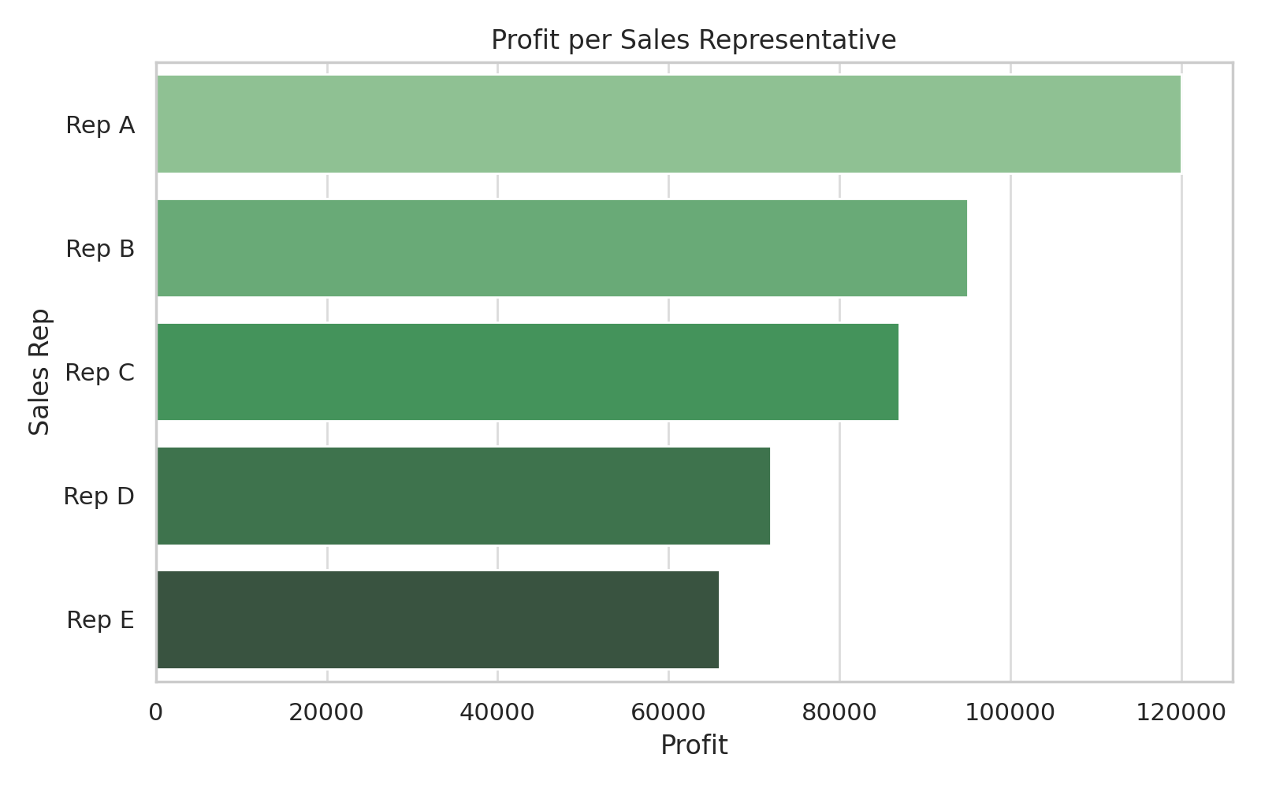
Sales Performance by Employees
Top Performer: Julie Firrelli (Boston) with $491K in revenue
Most Profitable: Sue Frick (San Francisco) with $266K net profit
Insights:
  Profit varies by rep despite high revenue; cost tracking is essential
  High-profit reps should mentor underperformers

Slide 6
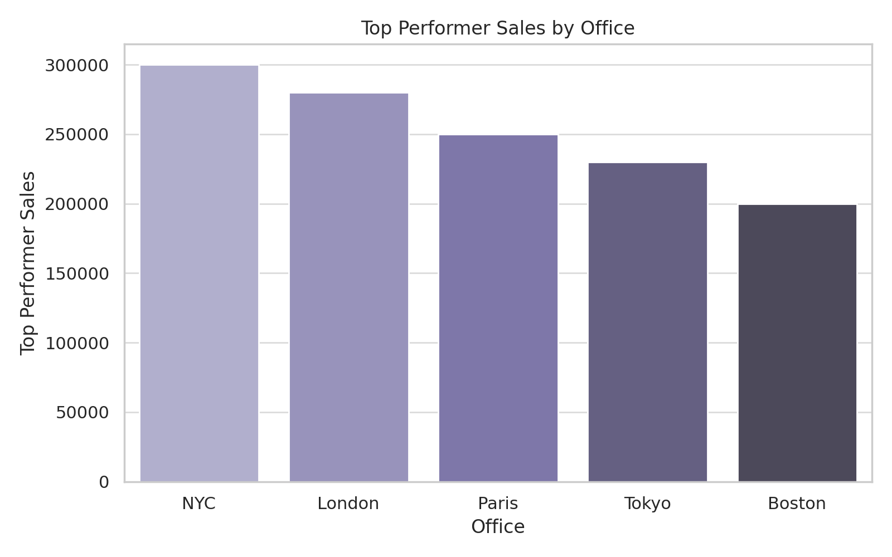
Office-Level Employee Performance
Top Offices: Boston, Paris, and NYC lead in sales contributions.
Star Performers:
  Julie Firrelli (Boston)
  George Vanauf (NYC)
Insights:
  Offices with strong leadership and market presence perform better.
  High performers can serve as mentors to boost overall office performance.
Recommendations:
  Promote peer mentoring from top reps.
  Replicate strategies from successful offices in underperforming ones.

Slide 7
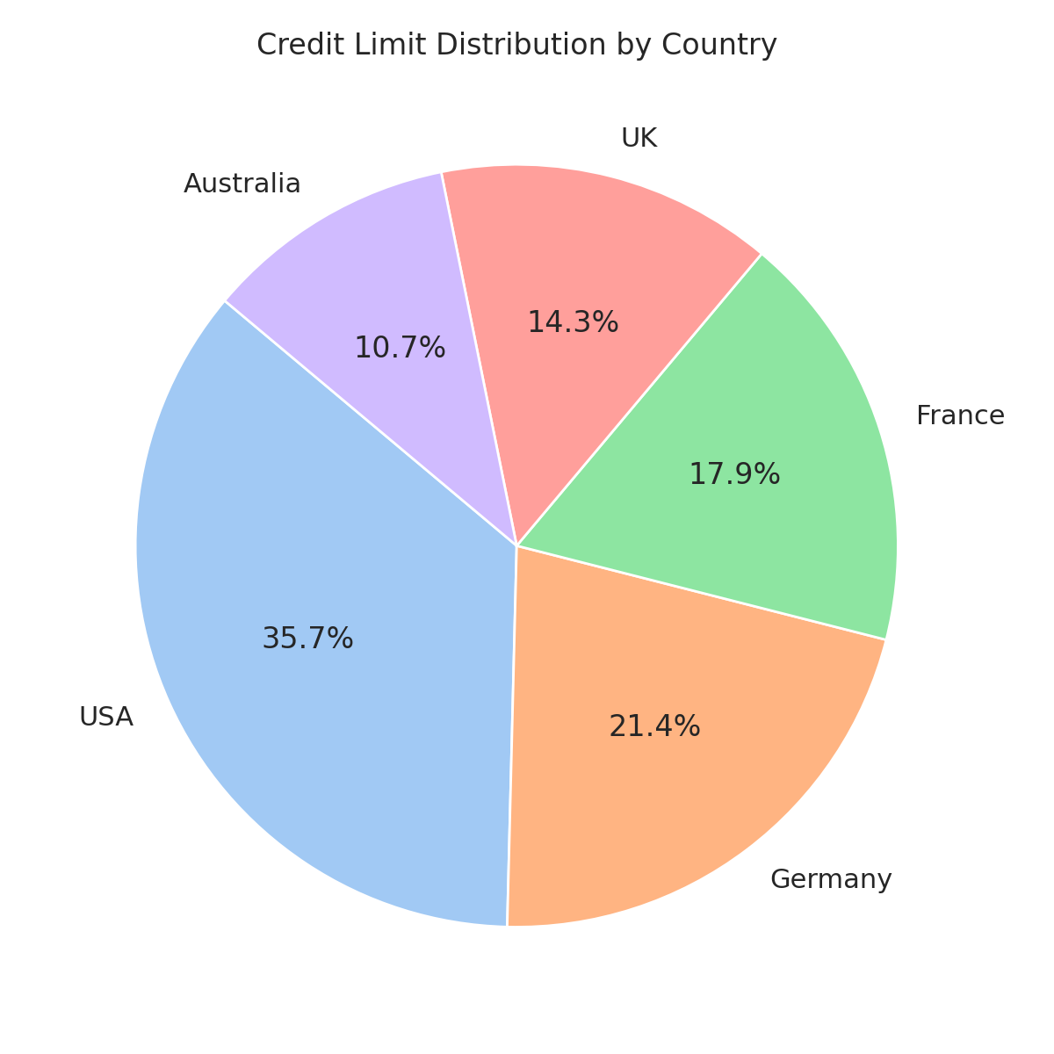
Customer Distribution & Credit Insights
Highest Credit Limit: $210,500 (Mini Gifts Distributors Ltd.)
Dormant Customers: 20+ detected
Country Trends:
  France and Australia show high average credit limits
Actionable Insight:
  Target high-credit regions for premium product marketing

Slide 8
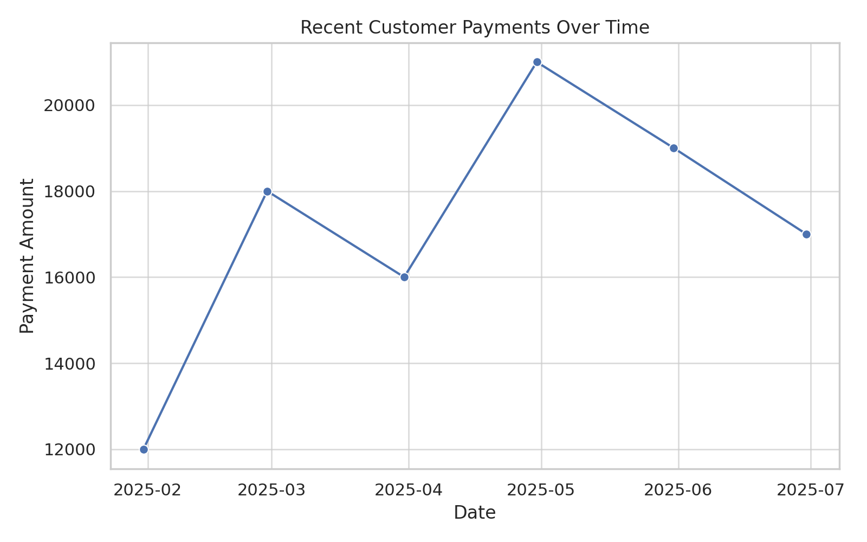
Customer-Rep Relationship
Customer–Rep Mapping: Each customer is directly tied to a specific sales representative, enabling performance tracking and personalized follow-up.
Payment Activity: Recent payments show steady engagement, with notable spikes in Q2.
Credit Overshoot Alerts: Some customers have exceeded their credit limits — potential risk or upsell opportunity.
Actionable Insight:
  Monitor high-activity customers and consider credit reviews or loyalty offers.
  Reassign inactive accounts to reps for targeted re-engagement.

Slide 9
Office & Territory Analysis
Staffing Snapshot: Most offices are well-staffed, but a few operate with limited or no personnel.
Unstaffed Locations: At least one office has no employees assigned — may indicate underutilization or inactive operations.
Territory Coverage: Offices are distributed across key regions: North America, EMEA, APAC, and Japan.
Key Takeaway:
  Review resource allocation and performance in low-staffed regions.
  Explore restructuring or targeted hiring to improve regional efficiency.

Slide 10
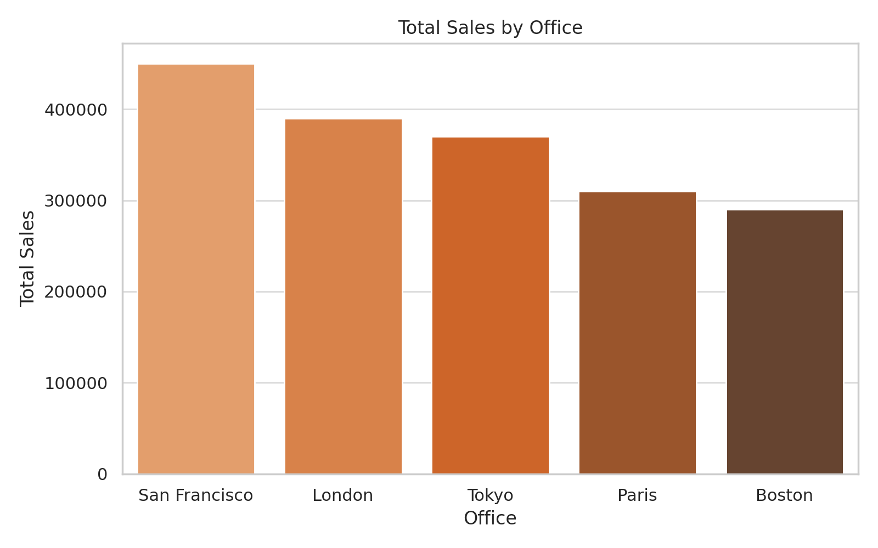
Office Performance & Credit
Highest Revenue Office: Paris leads with over $1.04 million in total revenue, highlighting strong regional demand and sales effectiveness.
Credit Insight: Tokyo office handles high-credit-limit customers, ideal for premium service and product offerings.
Strategic Recommendation: Focus investment, marketing, and support resources in regions with proven revenue performance and credit strength.

Slide 11
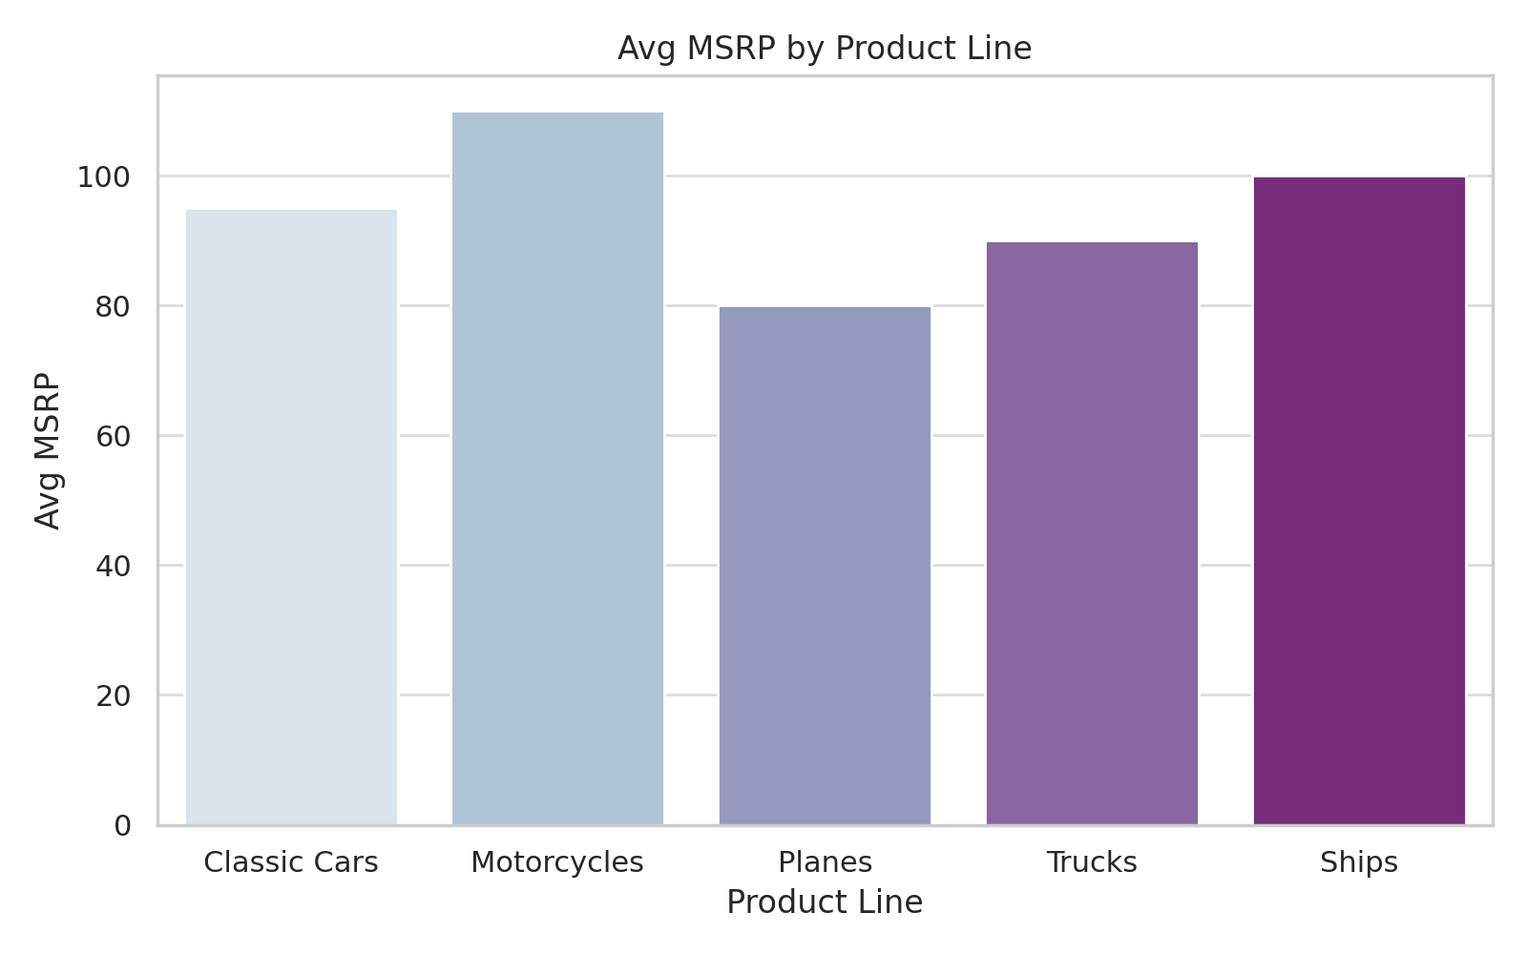
Product Line Insights
Top Product Line by Volume: Classic Cars leads with the most extensive catalog and consistent demand across regions.
High-Value Line: Motorcycles have the highest average MSRP, positioning them as a premium segment for upselling and targeted marketing.
Strategic Pricing Band: Over 25 products fall within the $50–$100 range, appealing to a wide customer base—ideal for promotions and bundles.
Actionable Insight: Focus on optimizing inventory and campaigns around best-selling categories and profitable price ranges to maximize return.

Slide 12
Product Sales & Inventory Health
Top Revenue Generator: Classic Cars dominate sales with over $2.3 million in total revenue, indicating strong and steady demand.
Inventory Risk Areas: Over 10 products fall below the critical inventory threshold (<10 units), especially within high-demand lines like Classic Cars and Motorcycles.
Premium Stock Insight: The most expensive product—Harley Davidson Eagle—is priced at $115.90 MSRP, highlighting an opportunity for high-margin sales.
Critical Point: Implement proactive inventory management for best-sellers to prevent stockouts, especially in top-performing product lines.

Slide 13
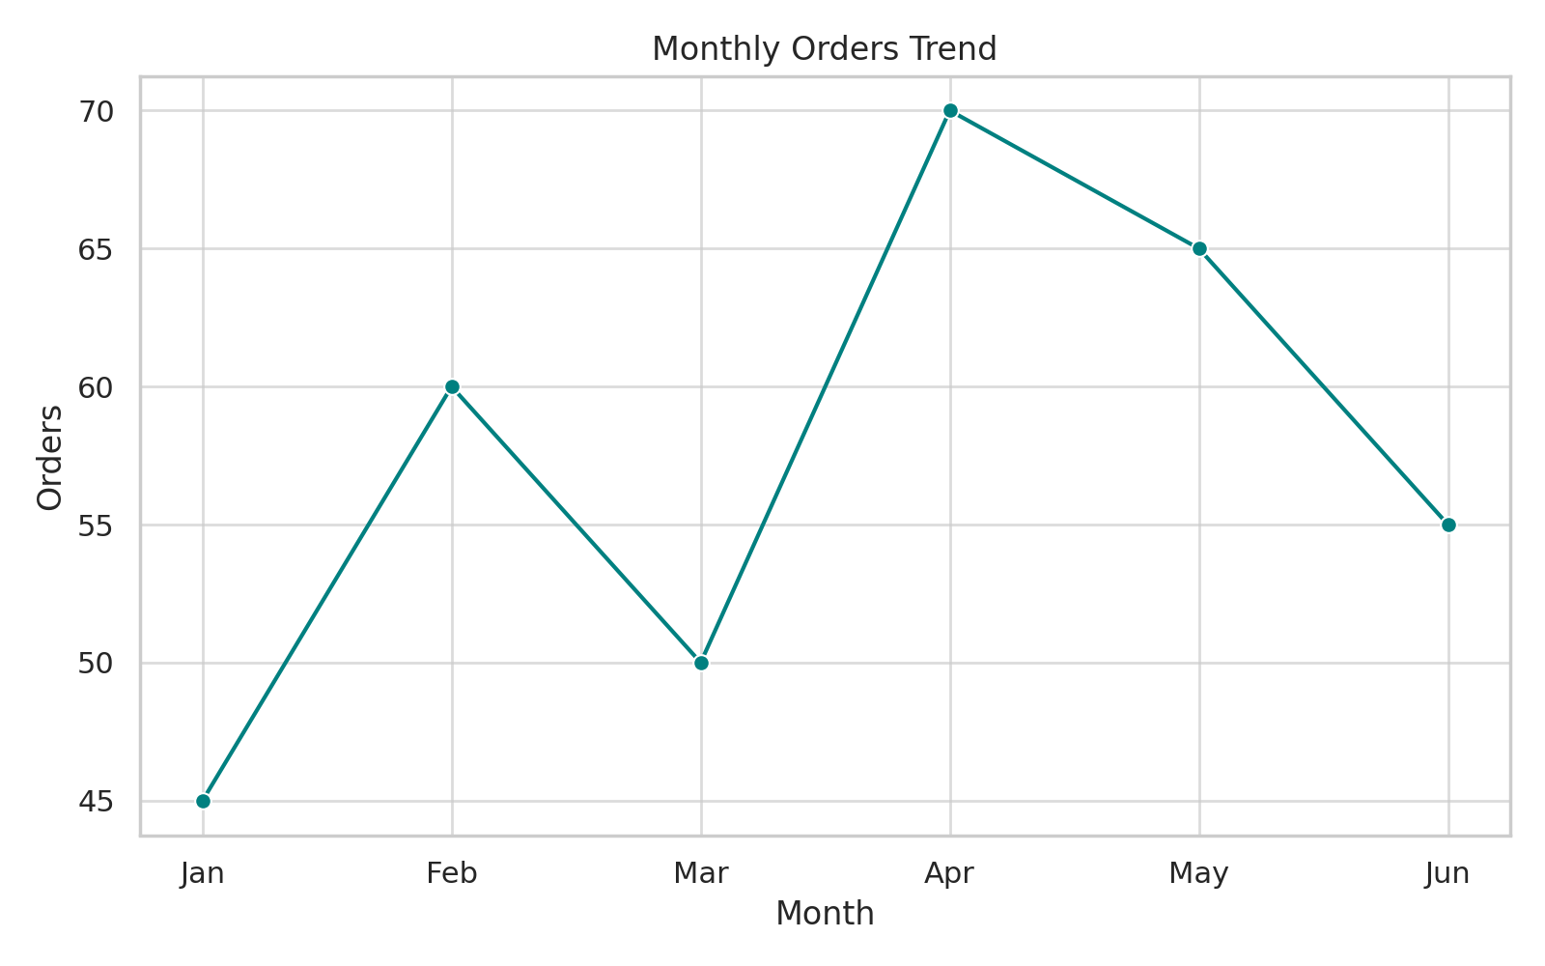
Customer Order Trends
Average Order Value: Approximately $3,200 per customer, reflecting consistent transaction strength and customer value.
Monthly Order Trends: March and November stand out as peak months, pointing to seasonal buying behaviors—possibly aligned with product launches, end-of-quarter incentives, or holidays.
Order Recency: Recent transactions continue as of July 2025, demonstrating ongoing engagement.
Strategic Insight: Align promotional campaigns with peak periods, and introduce loyalty incentives during off-peak months to maintain sales continuity.

Slide 14
Product & Order Profitability
Top-Selling Product by Quantity: The 1969 Dodge Charger leads with 120 units sold, validating its strong market demand within the classic category.
Highest-Grossing Order: Order #10107 brought in $23,400 in revenue, highlighting opportunities to analyze and replicate high-value customer behavior.
Product Pairing Insight: Frequently paired products like Ferrari and Mustang suggest organic bundling potential and customer preference patterns.
Strategic Recommendation: Use product pairing data to develop targeted bundle offers and upsell tactics. Focus on replicating successful high-profit orders through segmentation.

Slide 15
Automation & Strategic Takeaways
Better Credit Control: Automatically managing credit helps prevent overspending and keeps finances in check.
Smarter Inventory Decisions: Inventory tracking makes it easy to know when to restock popular items and avoid running out.
Strengthen Operational Control: Automation reduces manual errors, enforces policy compliance, and increases transaction transparency.
Support Data-Driven Growth: With clean, reliable data from automated processes, leadership can make confident strategic decisions.
Scale Efficiently: As the company grows, these automated processes reduce the burden on staff and sustain operational consistency.

Slide 16
Conclusion
This project offered a practical, data-backed view of how the business performs across multiple areas. Using SQL queries and automation, we uncovered insights that can directly shape strategic decision-making:
  Team Insights: Recognized top-performing employees and offices to help HR make informed staffing and training decisions.
  Customer Insights: Highlighted key buyers, dormant customers, and credit patterns to improve targeting and engagement.
  Product Insights: Identified best-selling, most profitable, and low-stock products to guide marketing and inventory planning.
  Automation Insights: Demonstrated how SQL triggers can reduce manual work and improve accuracy in credit and inventory management.
Final Thought: These insights empower the business to grow smarter—not just bigger—by making decisions grounded in data and automation.

